Slide 1
SMTP Relaying Over Delay-Tolerant Networks
Sponsored by NASA JPL
Notes:
Brian Contreras

Slide 2

Our Team
Leigh Torgerson (JPL)
Liaison
Manveen Kaur
Faculty Advisor
Student Team
Lance Batac
Brian Contreras
Adrian Flores Aquino
Jiahao Li
Sophia Liwag
Nathan Luu
Nicholas Martin
Antonio Ortega
Anderson Pena
Ryan Torrez
Jilei Zou
Notes:
This section will be used as a small introduction of the Teasm: Brian Contreras

Slide 3

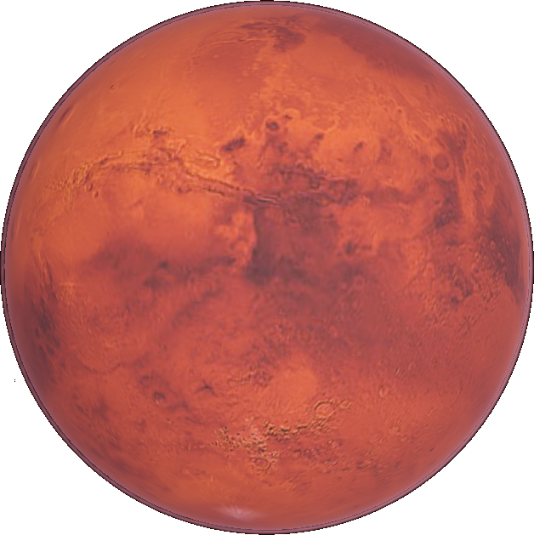

Objective
The goal of this project is to use DTN protocols to build a line of communication through email between Earth and an Extraterrestrial Body.
Brian Contreras
Notes:
Really Brief overview of the project ( Brian Contreras)

Slide 4
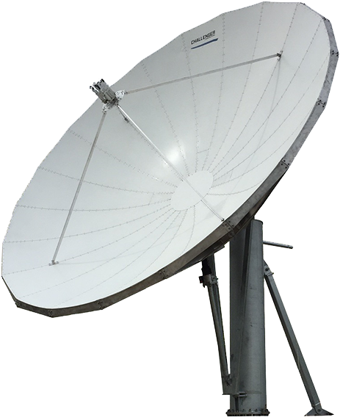
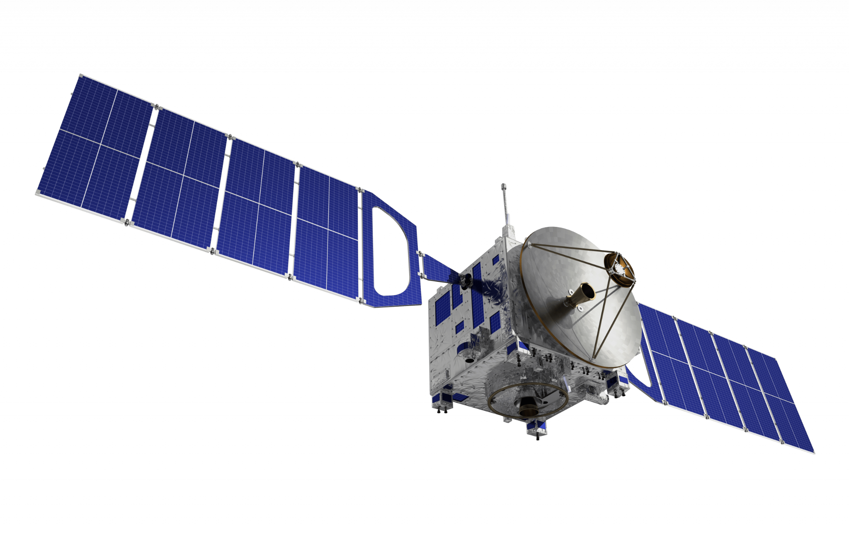

Table of Contents
1
How Email Works
2
Traditional IP Suite Doesn’t Work in Space
3
Store and Forward & Delay Tolerant Networking
4
Email Relaying in Space
5
Progress and Plans
Brian Contreras
Notes:
Brian Contreras

Slide 5
Why not send through regular Internet Protocols?
The main issue with Deep Space communication is the lack of Network Nodes available.
This results in:
High Latency
Large consumption of Bandwidth ($$$$$)
Insecure
Extreme Likely Data does not reach target
140 million miles

Slide 6
01
How Email Works

Slide 7
Simplified Internet Mail Architecture
Email has three stages: submission, relay, and access
Sender
Recipient
Message delivery agent (MDA)
Message transfer agent (MTA)
2: Relay
Message transfer agent (MTA)
Message delivery agent (MDA)
Message store (MS)
Message submission agent (MSA)
Message submission agent (MSA)
Message store (MS)
1: Submission
3: Access
Message user agent (MUA)
Message user agent (MUA)
Adrian Flores
Notes:
[Adrian]

Slide 8
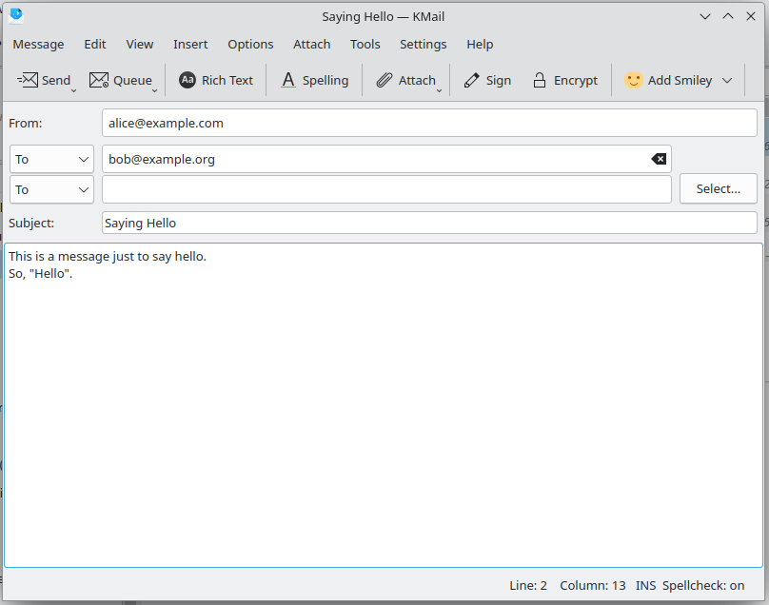
Example
Alice <alice@example.com> wants to send a message to Bob <bob@example.org>
Message user agent (MUA)
Adrian Flores
Notes:
[Adrian]

Slide 9
Alice's client submits her message to the example.com mail server
From: Alice <alice@example.com>
To: Bob <bob@example.org>
Subject: Saying Hello
Date: Tue, 26 Nov 2024 03:49:30 -0800
Message-ID: <1234@fedora>
This is a message just to say hello.
So, "Hello".
Remote Server
Message user agent (MUA)
Message submission agent (MSA)
Submission
Alice's mail client
example.com mail server
Adrian Flores
Notes:
[Adrian]

Slide 10
Relaying
Messages hop between mail servers until they reach their destination.
Relaying happens between the message transfer agent (MTA) component of mail servers
Final destination
Message delivery agent (MDA)
Message transfer agent (MTA)
MTA
MTA
MTA
…
Alice's mail server
Mail server X
Mail server Y
Bob's mail server
Relaying
Adrian Flores
Notes:
[Adrian]
"The Message Transfer Agent, or MTA, is responsible for getting an email closer to its final destination. Emails pass through a series of MTAs in a process called relaying. The email is routed to an MTA progressively closer to the recipient’s domain at each hop. Once the email reaches the final MTA for the destination domain, it hands off the message to a Message Delivery Agent (MDA), which ensures the email is stored and made available for retrieval by the recipient. This process is similar to routing on a network, with each step ensuring the message gets closer to its target.

Slide 11
What to Know About Relaying
What protocol is used
What mail server should the message hop to
Jeremy Zou
Notes:
[Jeremy]
"When relaying emails, two key questions are: what protocol is used and where should the message go next? SMTP over TCP port 25 is always used for relaying. To determine the next mail server, MTAs rely on DNS to find the recipient domain’s MX record."

Slide 12
Simple Mail Transport Protocol (SMTP)
Alice's MTA
Some MTA
(Open connection)
220 mail.something.com ESMTP Implementation
EHLO mail.example.com
250 mail.something.com at your service, mail.example.com
Application protocol using TCP port 25
Chatty: client sends commands and server responds
MAIL FROM:<alice@example.com>
250 Ok
RCPT TO:<bob@example.org>
250 Ok
DATA
354 End data with <CR><LF>.<CR><LF>
(Alice's IMF message)
250 Ok
QUIT
221 Bye
Jeremy Zou
Notes:
[Jeremy]
"SMTP is an application protocol used for email relay, operating over TCP port 25. It’s a 'chatty' protocol, where the sender’s MTA communicates with another MTA through a sequence of commands and responses. The process starts with EHLO to introduce the server, followed by MAIL FROM and RCPT TO to specify the sender and recipient. The DATA command transmits the email content, and the session ends with QUIT. Each step is acknowledged to ensure proper delivery.“

Slide 13
DNS Mail Exchange (MX) Records
Recipient is bob@example.org, so find the MX record of example.org.
Root name server
2: Iterative query
3: org
Alice's MTA
1: Recursive query
Recursive resolver
4: Iterative query
.org name server
8: mail.example.org
5: example.org
6: Iterative query
example.org name server
7: mail.example.org
Anderson Pena
Notes:
Anderson

Slide 14
Alice's MTA uses SMTP over TCP port 25 to relay her message to mail.example.org
Bob's mail server realizes the message is at its destination and stores Alice's message in Bob's mailbox
MS
Store in Bob's mailbox
MDA
SMTP TCP port 25
MTA
MTA
mail.example.com (Alice's mail server)
mail.example.org (Bob's mail server)
Anderson Pena
Notes:
Anderson

Slide 15
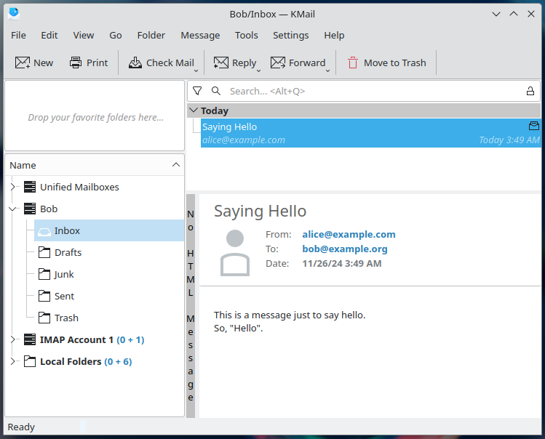
Alice's Message on Bob's Machine
Message transfer agent (MTA)
Message delivery agent (MDA)
Message submission agent (MSA)
Message store (MS)
3: Access
Message user agent (MUA)
Anderson Pena
Notes:
Anderson

Slide 16
Internet Mail Architecture Summary
example.org. 3600 IN MX 10 mail.example.org.
MS
MS
Recursive resolver
3: Access
MDA
MDA
mail.example.org
Bob's MUA
2: Relay (SMTP)
DNS MX query
MTA
MTA
Alice's MUA
1: Submission
MSA
MSA
example.com mail server
example.org mail server
Anderson Pena
Notes:
Anderson

Slide 17
02
Traditional IP Suite Doesn't Work in Space

Slide 18
Internet Structure in Space
Limited Infrastructure
Rerouting less practical
Connections are End-End
Potential delays & errors
Sophia Liwag
Notes:
Sophia

Slide 19
Challenging Environments
Many variables in space causes many interruptions with connectivity
Examples:
cosmic radiation
signal attenuation
interference
etc.
Sophia Liwag
Notes:
Sophia

Slide 20
Large Distances
More opportunities for interruptions to occur
More latency
Takes longer to deliver a message
Sophia Liwag
Notes:
Sophia

Slide 21
Problems with Current Protocols in Space
Cyber threats
Unreliable
High error rates
Sophia Liwag
Notes:
Sophia

Slide 22
Problems with End-to-End Connections in Space
Fragile
Round-Trip Times (RTTs) are variable & lengthy
Wastes progress between ends
Lance Batac
Notes:
Lance

Slide 23
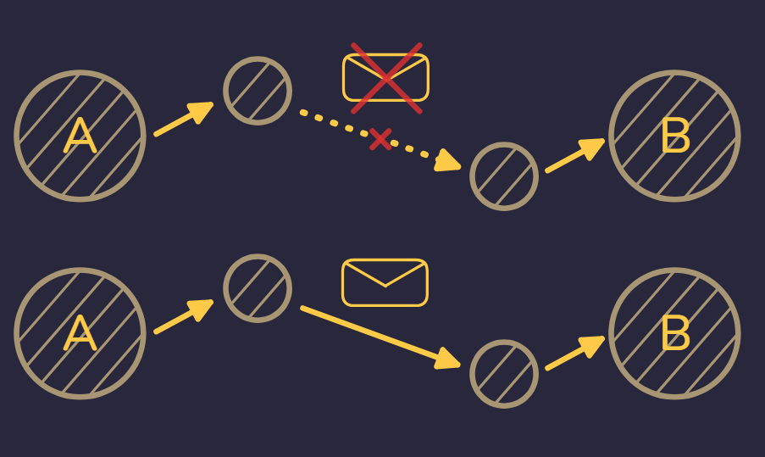
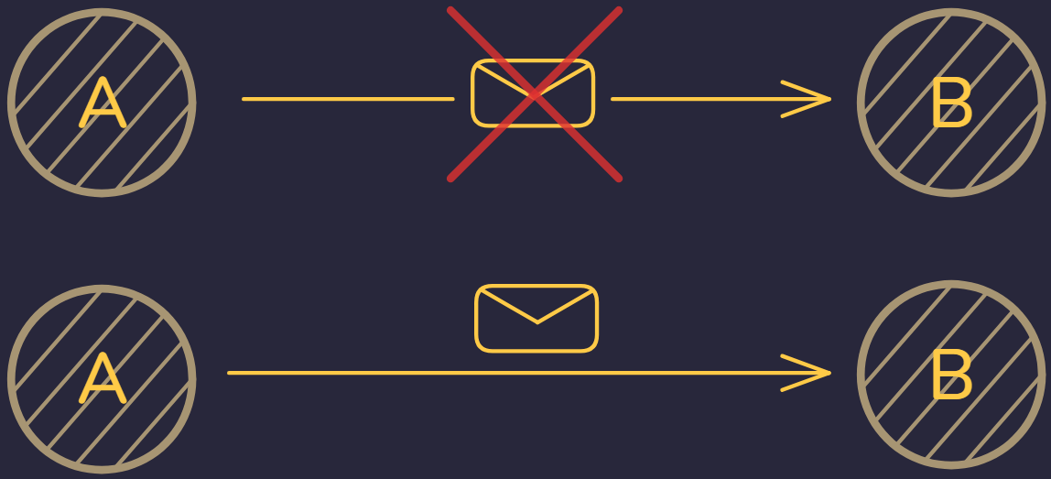
Interrupted E2E transmissions, have to restart from the very beginning
Notes:
Section 3 - Lance and Sophia

Slide 24

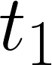

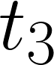
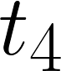
End-to-End Delivery
Source
1
1
1
1
1
Link up
Link down
1
1
1
1
Can't send data until E2E path is available
Destination
1
Time
Lance Batac
Notes:
Lance Based on diagram from page 10 https://www.usenix.org/legacy/events/lisa09/tech/slides/scott.pdf#page=10

Slide 25
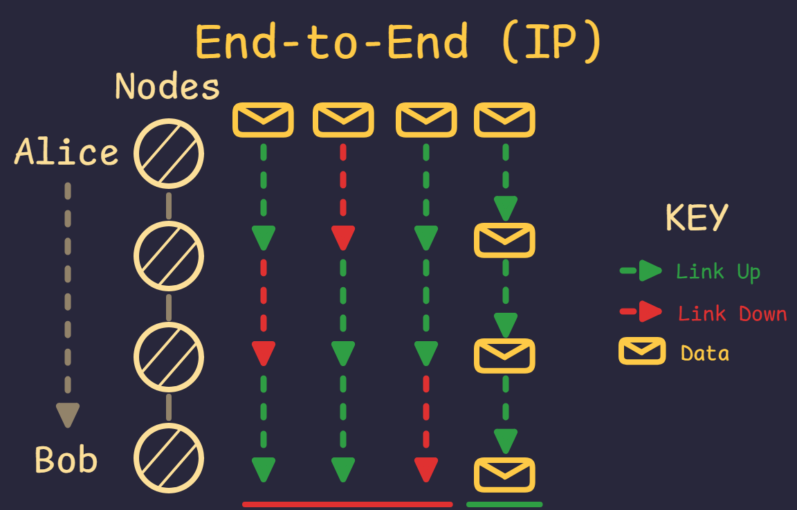
Interrupted E2E transmissions, have to restart from the very beginning
Notes:
Section 3 - Lance and Sophia

Slide 26
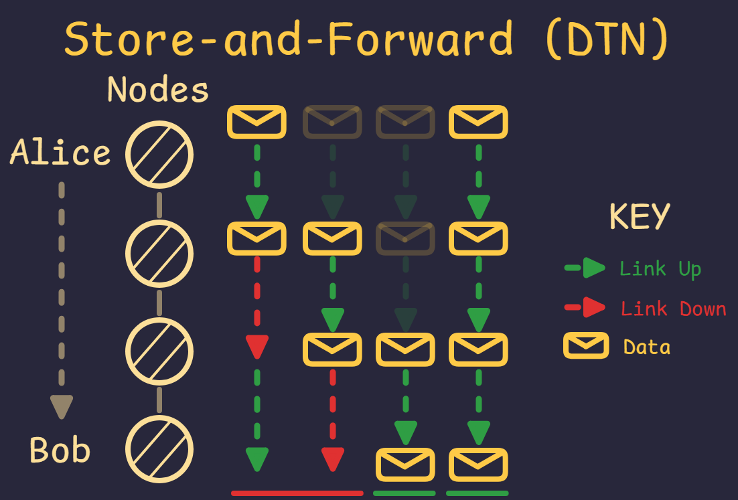
caption
Notes:
Section 4

Slide 27
What is Network Topology?
The Structure of a Network
Arrangement of nodes and links in a network
Enables Message Delivery
Provides a message’s destination

Slide 28
Why is it Important?
Enables Message Delivery
Defines how messages reach their destinations
Impacts
Routing efficiency
Fault tolerance

Slide 29
Problems w/ Network Topology
Deep space networks have slow, unpredictable message delivery.
Nodes may not agree on the network's structure.
This causes:
Errors in routing
Data getting lost
Bad network performance

Slide 30
Problems with DNS Queries in Space
Resolver too far
Name resolution becomes slow
So do applications that rely on name resolution
Lance Batac
Notes:
Lance

Slide 31
Problems with Remote DNS Servers
Communication between DNS resolvers
Longer delay to send and receive responses
Keeping records in sync becomes a hassle
Would use up too much bandwidth
Lance Batac
Notes:
Lance

Slide 32
03
Store and Forward and Delay Tolerant Networking
Notes:
Ryan T

Slide 33
Traditional TCP/IP Suite Design
Application layer and transport layer are only used at the beginning and end
Responsibility for ensuring data delivery is at the ends, not in between
Routers forward packet if possible; if not, drop the packet
Source
Destination
Application
Transport
TCP
TCP
Network
IP
IP
IP
IP
Link
Physical
Host
Router
Router
Host
Ryan Torrez
Notes:
Section 4 - slide 1(Ryan)

Slide 34
Store and Forward Model
Shift responsibility from only the ends to the rest of the network
Hand the data you want to reach some destination to someone closer to your destination; now it's their responsibility to pass your data on
Ryan Torrez
Notes:
Section 3 - Lance and Sophia or Ryan T

Slide 35
End-to-End Delivery
Source
1
1
1
1
1
Link up
Link down
1
1
1
1
Can't send data until E2E path is available
Destination
1
Time
Nicholas Martin
Notes:
Let's go back to the end-to-end delivery diagram. Since we could only send when we had an E2E connection, we only managed to send one piece of data and at time t = t₄.
Based on diagram from page 10 https://www.usenix.org/legacy/events/lisa09/tech/slides/scott.pdf#page=10

Slide 36
End-to-End Delivery
Source
1
2
2
3
3
Link up
Link down
1
1
2
2
3
1
1
2
3
Incremental progress w/o E2E path
Destination
1
2
3
Time
Nicholas Martin
Notes:
In contrast, if the nodes in between the source and destination can hold the data for us, not only does the data arrive at the destination earlier (at time t = t₂), but we also have more opportunities to send more data (we managed to send 3 pieces of data). So store and forwarding reduces latency and increases throughput.
Based on diagram from page 10 https://www.usenix.org/legacy/events/lisa09/tech/slides/scott.pdf#page=10

Slide 37
Delay-Tolerant Networking
Store and forwarding: main idea behind delay-tolerant networking (DTN)
DTN is implemented at the bundle layer, main protocol is bundle protocol (BP)
Application
Application
Bundle
Common to all DTN nodes
Transport (TCP)
Transport
Common to all Internet nodes
Network (IP)
Network
Specific to each DTN node
Link
Link
Specific to each Internet node
Physical
Physical
Internet Protocols
DTN Protocols
Jilei Zou
Notes:
https://www.nasa.gov/wp-content/uploads/2023/09/dtn-tutorial-v3.2-0.pdf#page=15
Slide 6
Nick

Slide 38
Application
Application
Transport (TCP)
Transport (TCP)
Internet routers deal with the network layer
Network (IP)
Link
Link
Link
Link
Physical
Physical
Physical
Physical
Host
Router
Router
Host
Application
Application
DTN nodes deal with the bundle layer
Bundle Protocol
Transport
Transport
Transport
Transport
Network
Network
Network
Network
Link
Link
Link
Link
Physical
Physical
Physical
Physical
Source Node
Forwarding Node
Forwarding Node
Destination Node
Jilei Zou
Notes:
Slide 7

Slide 39
04
Email Relaying in Space

Slide 40
Don't Replace TCP/IP Where It Still Works
These are all true, locally, on the Moon or on Mars:
Continuous E2E path between source and destination throughout a communication session
Networks have short delays
Retransmissions based on feedback from receivers is effective for repairing errors
E2E loss is small
Application layer doesn't worry about communication performance
Nathan Luu

Slide 41
Solar System Internet
"Worlds" of IP networks connected via BP
Lunar Internet
BP
Mars Internet
BP
Earth Internet
BP
Nathan Luu

Slide 42
Mailing Example Revisited
alice@example.com to bob@example.mars
MS
MS
Access
MDA
MDA
Bob's MUA
Relay
MTA
MTA
?
Submission
Alice's MUA
MSA
MSA
example.com mail server
example.mars mail server
On Earth
On Mars
Nathan Luu

Slide 43
Earth MTA
What do we send here?
Mars MTA
SMTP / BP?
SMTP / TCP / IP / BP?
Neither of these will work, SMTP at the application layer makes delay-intolerant assumptions
Bundle
Bundle
IP packet
SMTP protocol unit
TCP segment
SMTP protocol unit
Nathan Luu

Slide 44
Simply reusing SMTP means we still need to talk back and forth
Alice's MTA
Bob's MTA
(Open connection)
220 mail.example.mars ESMTP Implementation
HELO mail.example.com
250 Hello mail.example.com, I am glad to meet you
MAIL FROM:<alice@example.com>
250 Ok
RCPT TO:<bob@example.mars>
Nathan Luu

Slide 45
What if we sent all of the commands at once?
Alice's MTA
Bob's MTA
(Open connection)
220 mail.example.mars ESMTP Implementation
HELO mail.example.com
250 Hello mail.example.com, I am glad to meet you
MAIL FROM:<alice@example.com>
250 Ok
RCPT TO:<bob@example.mars>
Nathan Luu

Slide 46
Complete all of the "sending" aspects of the SMTP transaction at the sender, and have the receiver process all of those aspects at once
Alice's MTA
Bob's MTA
HELO mail.example.com MAIL FROM:<alice@example.com> RCPT TO:<bob@example.org> DATA
From: Alice <alice@example.com>
To: Bob <bob@example.org>
Subject: Saying Hello
Date: Sun, 24 Nov 2024 05:53:28 -0800
Message-ID: <1234@example.com>
This is a message just to say hello.
So, "Hello".
.
QUIT
HELO mail.example.com MAIL FROM:<alice@example.com> RCPT TO:<bob@example.org> DATA
From: Alice <alice@example.com>
To: Bob <bob@example.org>
Subject: Saying Hello
Date: Sun, 24 Nov 2024 05:53:28 -0800
Message-ID: <1234@example.com>
This is a message just to say hello.
So, "Hello".
.
QUIT
Bundle Protocol
Network
Nathan Luu

Slide 47
Two Separate Email Processes On Separate Internets
1: Submission
2: Relay
3: Access
5: Submission
6: Relay
7: Access
4: Data Transfer
Solar System Internet DTN
Earth Internet
Mars Internet
BP
BP
Nathan Luu

Slide 48
SMTP Data Object
SMTP commands are for when we're using SMTP.
Since we're submitting a new message at Mars, we just need the same thing Alice used for submitting: her message.
MAIL FROM:<alice@example.com>
250 2.1.0 Ok
RCPT TO:<bob@example.org>
250 2.1.0 Ok
DATA
354 End data with <CR><LF>.<CR><LF>
From: Alice <alice@example.com>
To: Bob <bob@example.org>
Subject: Saying Hello
Date: Sun, 24 Nov 2024 05:53:28 -0800
Message-ID: <1234@example.com>
This is a message just to say hello.
So, "Hello". .
Nathan Luu

Slide 49
Only send the message and begin a new submission on the other side
Alice's MTA
Bob's MTA
MSA
From: Alice <alice@example.com>
To: Bob <bob@example.org>
Subject: Saying Hello
Date: Sun, 24 Nov 2024 05:53:28 -0800
Message-ID: <1234@example.com>
This is a message just to say hello.
So, "Hello".
Bundle Protocol
Network
From: Alice <alice@example.com>
To: Bob <bob@example.org>
Subject: Saying Hello
Date: Sun, 24 Nov 2024 05:53:28 -0800
Message-ID: <1234@example.com>
This is a message just to say hello.
So, "Hello".
Nathan Luu

Slide 50
Don't Do SMTP. Send Data For SMTP
The first solution is slightly more efficient (don't need to create a new envelope and less disk writes/reads) Big picture: don't actually do SMTP
Nathan Luu
Notes:
Section 3 - Lance and Sophia or Ryan T

Slide 51
Regardless of which method, Bob reads the messages with the regular mail access protocols over TCP/IP
Access over TCP/IP
MS
Bob's MUA
MDA
MTA
MSA
example.mars mail server
Nathan Luu

Slide 52
DNS Design Consequences
Have to spend time waiting for DNS queries to resolve and use a lot of bandwidth for DNS traffic
We can only have a single, globally unique root in the public DNS
Authoritative name servers are the source of truth for their domains
Sources of truth on other planets are simply far away
Nathan Luu

Slide 53
Workaround: Discrete DNS Systems
Each celestial body with its own IP network has its own discrete, global DNS
All hosts in the network are only aware of their world's DNS
All DNS requests start and end within the IP network
Proposed by Scott Johnson in draft-johnson-dtn-interplanetary-dns
Lunar Internet
Moon DNS
Earth Internet
BP
Mars Internet
BP
Mars DNS
Earth DNS
BP
Nathan Luu

Slide 54
Old Example With Discrete DNS Systems
Alice's mail server's query for example.mars. resolves to a IP/BP gateway
mail.example.com
something.com
mail.example.mars
Alice's MTA
3: Mail relay (SMTP)
Earth to Mars gateway
Mars to Earth gateway
7: Mail relay (SMTP)
Bob's MTA
4: BP
TCP/IP
TCP/IP
1: Recursive query
5: Recursive query
Recursive resolver
Recursive resolver
2: something.com
6: mail.example.mars
*.mars. 3600 IN MX 10 something.com.
example.mars. 45000 IN MX 10 mail.example.mars.
Nathan Luu

Slide 55
Preventing Split-Horizon DNS
We don't want multiple sources of truth
We don't want domains to be owned by different people depending on what planet we're on
Reserve a set of names in DNS that are dedicated only for off-world resources. Each world gets one of those names, and they're free to create subdomains under that
One way: create a new top-level domain (TLD) for each remote world
Nathan Luu

Slide 56
Top-Level Domains and Remote Worlds
Name servers for off-world domains are not "real". Must be gateways
Real authoritative name servers on Mars are under the mars TLD. Other worlds have a wildcard *.mars pointed to gateways that can reach Mars
On Mars, every current TLD (com, net, org, gov, etc.) has a wildcard record pointed to gateways that can reach Earth
Earth DNS
Mars DNS
com
net
org
mars
com
net
org
mars
Off-world
Off-world
example
wikipedia
example
news
Nathan Luu

Slide 57
Summary
BP Network
BP
BP
BP impl.
BP impl.
example.mars. 45000 IN MX 10 mail.example.mars.
*.mars. 3600 IN MX 10 something.com.
The application between the BP impl. and the MTA is our project
MTA
MTA
5: Recursive query
Recursive resolver
7: Relay (SMTP)
4: Relay
(SMTP)
6: mail.example.mars
3: something.com
MTA
Recursive resolver
2: Recursive query
MTA
MDA
Alice's MUA
MSA
MS
8: Access
Bob's MUA
1: Submission
example.com mail server
example.mars mail server
On Earth
On Mars
Nathan Luu

Slide 58
05
Progress and Plans

Slide 59
August
Aug
Sep
Oct
Nov
Start of the project
Presentation from liaison on DTN
Introduction to team
Research
Research on emails how they work
Learned protocols, components, and structure of emails
Answers varied as did sources

Slide 60
September
Aug
Sep
Oct
Nov
Research
Research into email continued
Introduction to DNS and Internet
Explore DTN
Bundle protocol (BP)
Share interpretations of DTN

Slide 61
October
Aug
Sep
Oct
Nov
Virtual Machines (VM)
Experiment with setting up mail servers
docker-mailserver (Postfix for MSA/MTA and Dovecot for MDA/MS)
CoreDNS
Self-signed SSL certificates
Reviewed drafts on using SMTP and DNS in space
Marc Blanchet
Domain Name System in Mostly Isolated Networks
Encapsulation of Email over Delay-Tolerant Networks (DTN) using the Bundle Protocol
Scott Johnson
An Interplanetary DNS Model
A method for delivery of SMTP messages over Bundle Protocol networks

Slide 62
November
Aug
Sep
Oct
Nov
Documentation
SRD: Consolidated research + considered requirements
Presentation: Simplified + made research presentable for general audience
Raspberry Pi Test bed
Four Raspberry Pis
Two serve as Earth nodes
Two serve as Mars nodes
Discrete DNS systems per planet
One Pi serves as a regular mail server on the planet. Other serves as gateway

Slide 63
Current Work
Aug
Sep
Oct
Nov
Start of the project
Research emails
Research emails and general internet
Explore DTN
Virtual Machines (VM)
Drafts (Marc¹, Scott²)
Documentation
Pi test Bed
[1] https://datatracker.ietf.org/doc/draft-many-deepspace-dns-isolated-networks/
[2] https://datatracker.ietf.org/doc/draft-johnson-dtn-interplanetary-dns/
Antonio Ortega
Notes:
Presented by Antonio

Slide 64
Testbed
Antonio Ortega
Earth
Mars
rpi504
rpi505
rpi503
Name server (BIND 9)
Name server (BIND 9)
rpi506
MTA (Postfix)
MTA (Postfix)
MTA (Postfix)
MTA (Postfix)
MDA (Dovecot)
BP impl. (ION)
BP impl. (ION)
MDA (Dovecot)
example.com mail server
192.168.1.3
Earth gateway
192.168.1.4 ipn:4
Mars gateway 192.168.1.5 ipn:5
example.mars mail server 192.168.1.6
Notes:
Presented by Antonio

Slide 65
Future Work / Roadmap
Feb
Mar
Apr
May
Begin development (Split into teams focused on mailing and on DNS)
Iterate on testing and development, begin implementing more advanced features
Stress testing and further refinement; prepare required documentation
Finalize documentation; prepare for design expo
Brian Contreras

Slide 66
Thanks For Listening
Any Questions?

